Slide 1


XYZ Devops Transformation Training
Steve Bishop
Presented by
Notes:
25 years of experience developing software
11 years of workforce training experience
Specialize in Agile and DevOps transformations
Former golf professional

Slide 2

Agenda
Introduction
The Challenges
Goal and Objectives
Techniques and Skills
Delivery Structure
Personas
Impact
Notes:
Introduction
The Challenges
Goal and Objectives
Techniques and Skills
Delivery Structure
Personas
Impact

Slide 3
Introduction
25 years of experience developing software
11 years of workforce training experience
Program Developer, Workforce Trainer and Dojo Facilitator
Expertise in Agile and DevOps transformations
Former golf professional
Steve Bishop

Slide 4
Introduction
Liatrio is a company dedicated to being a catalyst for change.
We enable our customers to deliver value faster and safer by empowering people, teams, and organizations through modern DevOps practices and Cloud technologies.
We do this by:
Being an ally for our customers
Seeking continuous improvement
Facilitating a culture of feedback
Express strong opinions loosely held
Building a community
Notes:
Partners with organizations to train their workforce on DevOps and cloud technologies.
Host workshops and dojos to create interactive learning environments facilitated by subject matter experts
Developers get hands on training experience using technologies relevant to the work they’re already doing

Slide 5
The challenges
Why are we here?

Slide 6
The Challenges
Product Environment
Long Lead Times
Lack of Consistency
Developers are having a difficult time provisioning and establishing product environments which is extending the period of time it takes to deliver them.
The value stream to bring a new feature to production and accumulated technical debt is causing longer lead times.
Development and production environments are of varying consistency leading to unique challenges for each product and causing higher expenses.
Notes:
Product Environment – Provisioning new infrastructure to host and run both the development and production environments is taking considerable time.
Long Lead Times – There are multiple blockers in the working process of how work gets to and from the team as well as some technical debt in the code that causes delays in delivering functionality.
Lack of Consistency – Developers are dealing with development environments that are different from the production environment as well as between products. They’re also writing to inconsistent coding standards making it more difficult to switch between tasks.

Slide 7
Goal and Objectives
What are our targets?

Slide 8

“Move XYZ's on-premises product suite to a cloud-based solution while also improving the sustainability of XYZ's products”
- The Primary Goal
Notes:
Let’s start with a singular coalescing idea that clarifies our mission for the delivery of this program.
This goal is the only thing that is inflexible, everything else is subject to change based on feedback and observation.

Slide 9

Objectives and Milestones
Continuous Integration and Continuous Delivery
CI/CD pipeline
Linter for all products
Containerize all products
Deploy code to the cloud (AWS)
Infrastructure as code
Up-skill students on TDD and ATDD
Implement DORA metrics
Establish a DevOps culture
Notes:
These objective and milestones have been identified as lower-level achievements we can make that help us achieve the ultimate goal.
Up-skill students on a Continuous Integration and Continuous Delivery mindset
Implement a CI/CD pipeline for automated code validation and deployments
Improve coding standards using a linter for all products
Utilize containerization as a tool to make infrastructure more modular and consistent
Start deploying code to the cloud to simplify provisioning new environments
Use an infrastructure as code platform to build more consistent and repeatable environments
Up-skill students on TDD and ATDD to provide a more sustainable delivery model
Implement DORA metrics to objectively measure the change in performance of the development process
Establish a DevOps culture to improve collaboration between teams

Slide 10
Techniques and Skills
What needs to be learned?

Slide 11

DevOps Techniques and Skills
Continuous Integration – Merging code frequently into a shared mainline using automated tests to validate its readiness.
Continuous Delivery – Always having the code in a state where it is ready to be deployed.
Infrastructure as Code – Using code to manage and provision your environments.
Test-Driven Development – Writing software always starts with a test describing expected behavior.
Acceptance Test-Driven Development – Start the TDD process with the business cases first.
Pair/Mob Programming – Two or more people work on the same problem together in real-time.
Linter – A tool that analyzes source code to flag stylistic errors and suspicious constructs.
DORA Metrics – A set of scientifically shown metrics that separate successful development groups from struggling development groups.
Containerization – A deployment process that bundles application code with all the files it needs to run on any infrastructure.
Notes:
CI – By merging code frequently into a mainline we can identify merge conflicts and bugs early in the development process which saves time and money.
CD – By always having code in a state where it’s ready to deploy it makes rollbacks and deployments fast and easy so that recoveries and updates are non-events.
IaC – If your infrastructure is expressed as code, it is inherently documented, allows you to automate the provisioning of resources, and can be version controlled so that rollbacks and upgrades aren’t difficult to manage.
TDD – When we write a test before our production code it ensures our code is always validated to work and less likely to break due to new feature writing.
ATDD – When we start with a test for a business case, we know the functionality is done to the satisfaction of the business when the test passes.
Pair/Mob – When we have two or more people working together simultaneously, we eliminating communication blockers so our code gets written faster and with fewer mistakes.
Linter – Linters ensure the code between modules is consistent even when it is written by different developers. This makes it easy to enforce coding standards and ensure developers can comprehend the code quickly.
DORA Metrics – DORA metrics can help diagnose areas of opportunity to improve the teams working process by targeting measurable outcomes without specifying a particular framework
Containerization – Containerization makes it so the environment the applications run in are the same environments they were built on ensuring we avoid the challenge of “well it works on my machine”. It also makes the code highly portable to the cloud.

Slide 12
Delivery Structure
How will this be achieved?

Slide 13

Pilot Cohort
Conference room on-site
Need table, chairs, whiteboard, and projector or big screen
2 teams
16 student maximum
6 weeks
Keep initial costs low
Discover unknowns and make refinements before scaling

Slide 14
Schedule
Observation Phase
Liatrio experts will be on location to observe and interact with pre-selected students who will attend the pilot cohort.
Development Phase
A dedicated team of Liatrio experts will curate and compile learning materials. This will involve the careful selection of pre-existing content and the creation of new content where necessary.
Delivery Phase
Liatrio DevOps subject matter experts will facilitate lectures, exercises, and Dojo sessions for hands-on training.
Reflective Phase
Final look at the program success and areas of opportunity with the Liatrio experts and XYZ stakeholders.
Notes:
Observation phase
Experts on location to observe and interact with students
Familiarize the team with the students
Understand their various working domains
Gather detailed information about the challenges
Enable the experts to prioritize the skills and tools
An opportunity for early identification of potential issues
Development Phase
Experts curate learning materials
Tailor the martials to the needs discovered during observation phase
Maximum 2 month window
Delivery Phase
Two half day sessions
First half introduces new concepts through short lectures and practical exercises
Second half is a dojo environment
Students apply knowledge to their own code bases
Instructors engage students during the dojo and provide guidance
Correct mistakes in real-time
Students will practice pair and mob programming while performing exercises and dojo work
Weekly retrospectives to evaluate the effectiveness of the new skills and practices
Reflective Phase
Based on the Kirkpatrick model of evaluating effectiveness of training
Begin to ask questions such as
How did the students react to the training?
How much did the students learn?
How much did the students change their behavior?
How much did the training impact the business?
30/60/90 day surveys

Slide 15
Delivery – Weekly Topics
Week 1
DevOps Intro
CI/CD
Week 2
Kubernetes Cont.
Week 3
AWS EKS
Week 4
AWS CodePipeline
Week 5
Week 6
Docker
Kubernetes
AWS Core Services
AWS ECR
AWS CodeCommit
AWS CodeBuild
AWS CodeDeploy
AWS CloudFormation
AWS CloudWatch
AWS X-Ray
TDD
ATDD
DORA Metrics
Review
TBD
Notes:
First 5 Weeks dedicated to prioritized topics
Last week dedicated to topics of need
Subject to change based on observations and feedback

Slide 16
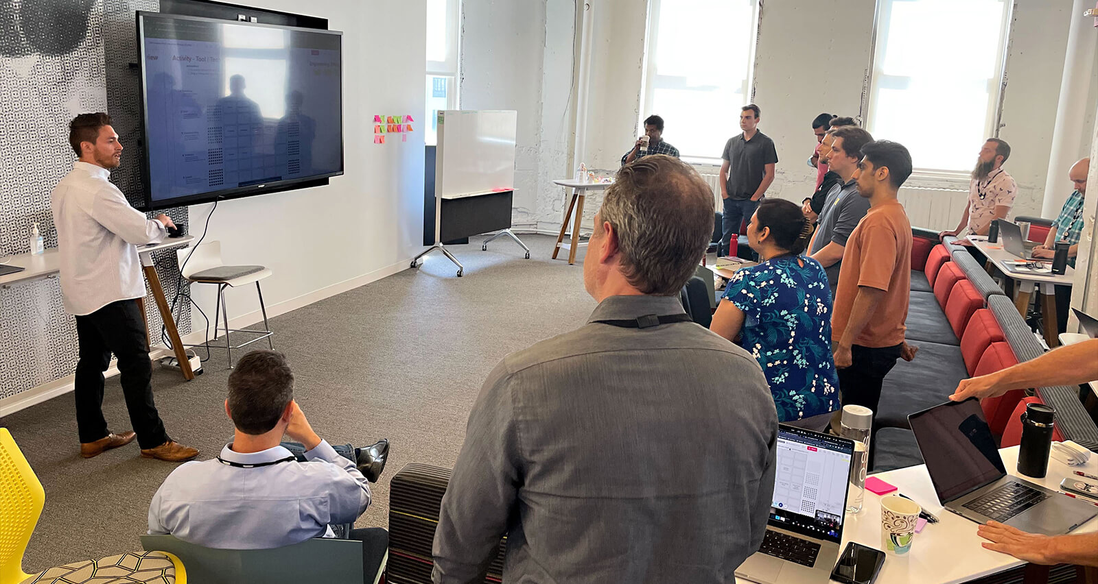
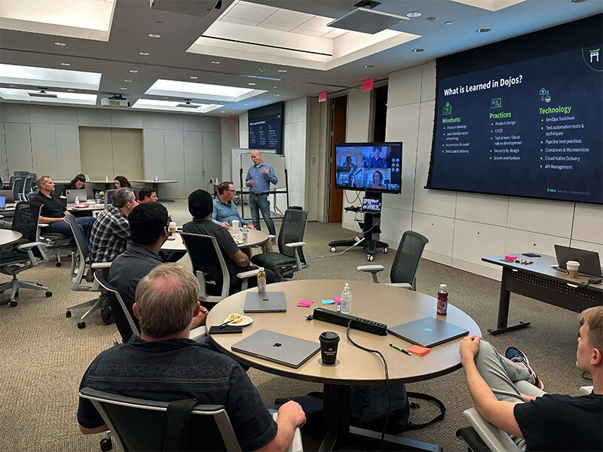
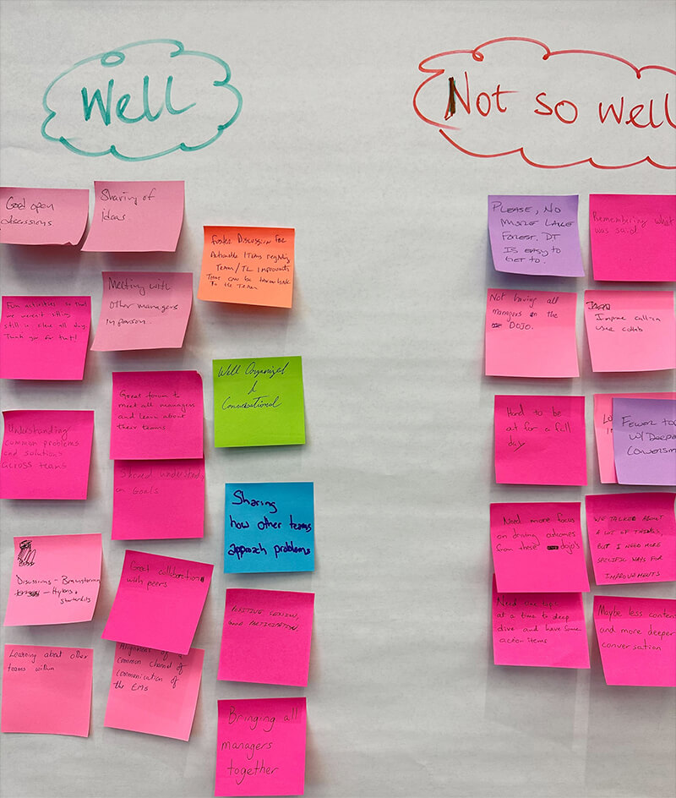
Morning Workshops
Short lecture (max 30 minutes) followed by an exercise
Students will be divided into groups of 2 or more
A goal for the groups to achieve and resources to achieve it
Instructors observe and engage with the students
Sandbox environment
Notes:
Each day will begin with a short lecture (max 30 minutes) followed by an exercise to practice that day's lesson.
Students will be divided into groups that work on exercises together to generate a culture of shared responsibility and communication
Workshops will have a goal for the groups to achieve and provided the resources necessary to achieve it
Instructors will regularly observe and engage with the students to provide guidance
Done in a sandbox environment where experimentation is encouraged

Slide 17



Afternoon Dojos
Student selected work
Instructors monitor, sit with, and work with students
Students perform work in groups
Instructors take note of any important subjects
Practical application of the skills
Notes:
Focus is on student selected production work
Instructors continue to monitor, sit with, and work with students as they go about their work
Students perform work in groups so as to reinforce the mentality of shared responsibility and communication
Instructors will take note of any important subjects that need to be added to the training
Practical application of the skills learned in the morning session

Slide 18
Personas
Who would benefit from this training?

Slide 19
Personas
Junior Engineers
Engineers who may have some exposure to DevOps but lack experience
Mid/Senior Engineers
Engineers who have access to tools but not know the full scope of their capabilities
Staff Engineers
Engineers looking to improve the quality of code deployments
System Architects
Architects looking for new technologies to help them solve some of the domain challenges they face

Slide 20
Impact
What impact will this have on the business?

Slide 21
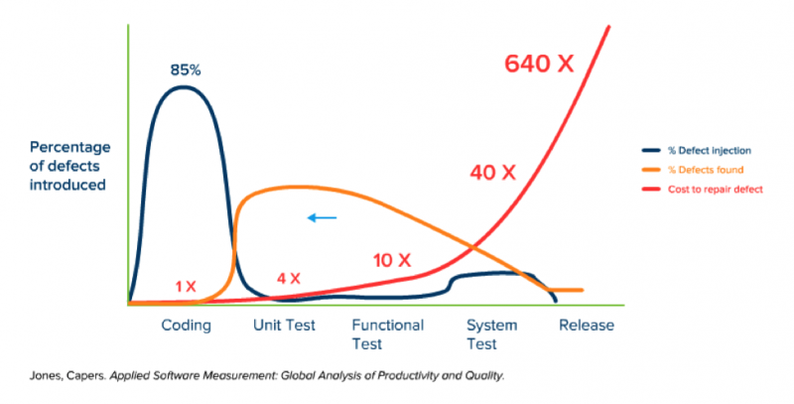
Traditional Deployments
Notes:
During traditional software development, as it goes through the various phases from initial coding through testing and then to release, the cost of recovering from defects grows exponentially. Notice the orange line and how very few defects are found during the coding process and by the time we get to releasing the code there are still several defects which we typically label as technical debt.

Slide 22
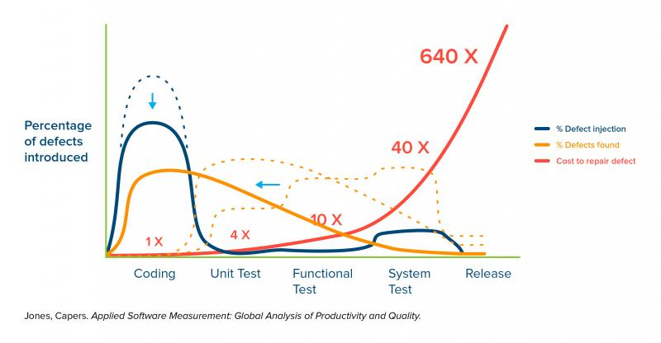
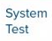
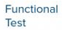
DevOps Deployment
Shift-Left Software Testing
Delivery
Notes:
When we shift the testing process to the left and make it a part of the development process we eliminate most of the defect right away so that mot of them are found before we get to releasing the code. This means we have far less technical debt to manage and fewer bugs to slow us down from delivering new functionality.

Slide 23
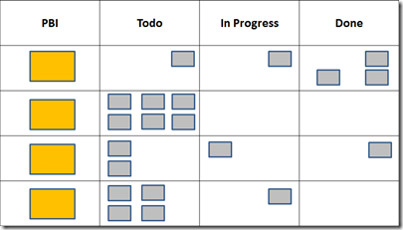


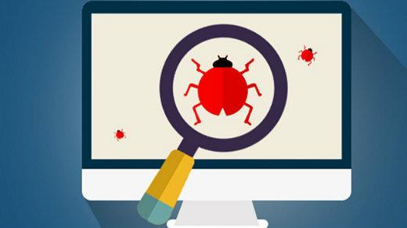

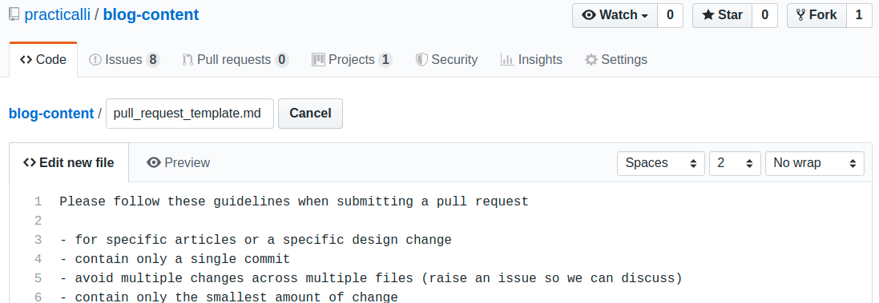

Notes:
In a traditional software development workflow:
When a new requirement is added, it goes to the backlog for the team that is assigned to work on it.
Then one of the members of the team writes the code to match the requirement
This is then followed by a merge request or pull request
One or more members of the team will then review the request to determine if there are any bugs
If there are bugs then the request is commented on and rejected until the fixes are completed
The original author of the code then makes their revisions to the code and submits the request again
If the code passes the second inspection then the code is authorized to be delivered in the next product build
If that build fails the original author of the code will often have to pass the request onto a deployment team that specializes in deploying to the environment
From that point on, the request goes into another backlog as a requirement and the cycle continues through the various layers until the feature is delivered

Slide 24




Pair/Mob
TDD/ATDD
CodePipeline
Kubernetes
EKS
Docker
AppConfig
Canary or
Blue/Green Deployment
CI/CD
Notes:
With DevOps practices in place
Those requirements can still go into a tracking board
The entire team works collaboratively which reduces development time by eliminating communication gaps
Test-First mentality means we go at a consistent pace that doesn’t take shortcuts
The development cycle includes a delivery phase after each small batch of code to ensure it’s always ready to deploy
A series of switches called feature flags indicate which features should be live to the end user
With these practices in place
Shorter Cycle Times from feature inception to delivery
Reduced risk of bugs introduced
Consistent Deliveries of functional software
Fast deployments that are ready when you are

Slide 25
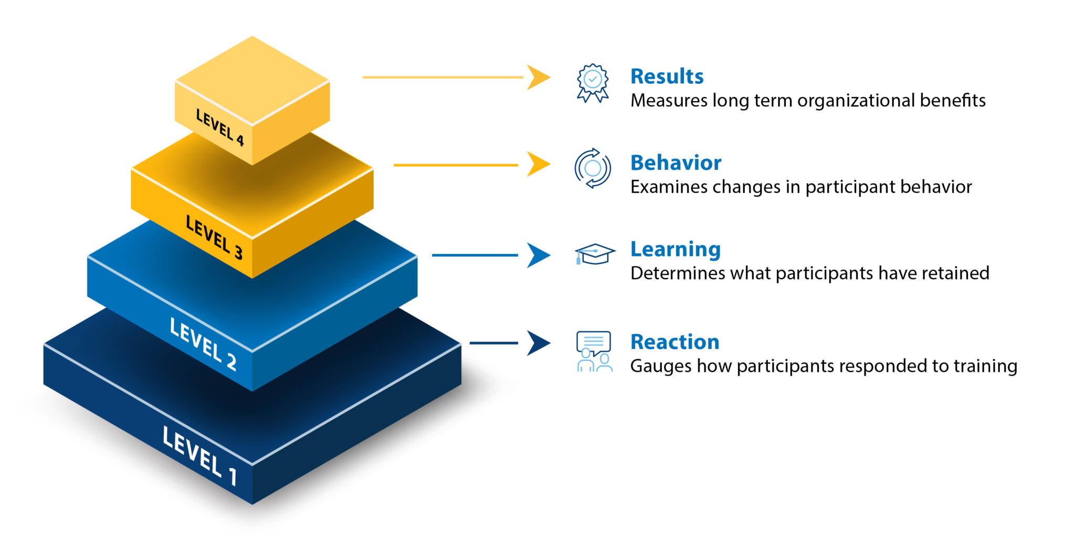
Kirkpatrick Model – Measuring Impact
Notes:
We’ll conduct retrospectives to get student reaction to the training and adjust
We’ll validate students have learned the material through instructor observation
We’ll look for changes in behavior through instructor and manager observation
We’ll implement DORA metrics to measure impact on products
Deployment Frequency—How often an organization successfully releases to production
Lead Time for Changes—The amount of time it takes a commit to get into production
Change Failure Rate—The percentage of deployments causing a failure in production
Time to Restore Service—How long it takes an organization to recover from a failure in production

Slide 26



Summary
Transformation Program
Shorter cycle times
Reduced risk
Consistent deliveries
Fast deployments
Collaborative environments
Measurable outcomes

Slide 27




Thank you
Steve Bishop
https://liatrio.com

